Slide 1
Introduction to Computer Programming Lecture 7.2:
Numpy Functionality
Hemma Philamore
Department of Engineering Mathematics

Slide 2
NumPy ("Numerical Python"): scientific computing applications
Fourier Transform
Shape Manipulation
Mathematical and Logical Operations
Linear Algebra
Random Number Generation

Slide 3
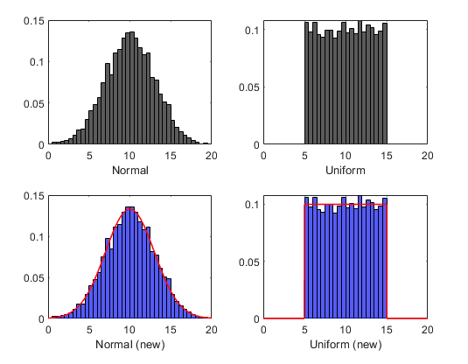


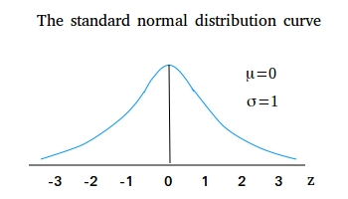
Random

Slide 4
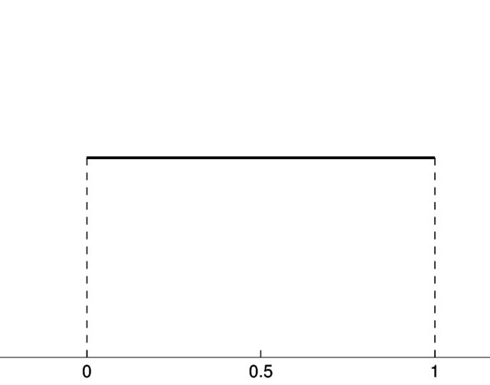
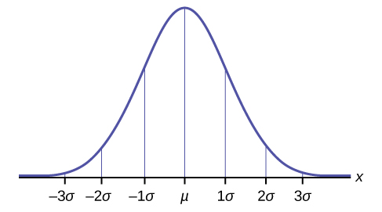
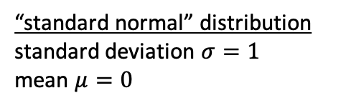

Random
Probability
Uniform
Probability
99.7% data
“standard normal” distribution standard deviation $σ=1$
mean $μ=0$
Gaussian/ normal
95% data
68% data
$$σ=\sqrt{\frac{\sum{{(x}_{i}−μ)^{2}}}{N}}$$
$x_{i}=$ value i
$μ=$population mean
$N=$size of population
Notes:
Messed up explanation. Redo

Slide 5




Min/Max
max
matrix
min
n vals

Slide 6
Min/Max
max
matrix
min
n vals

Slide 7
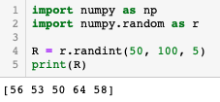
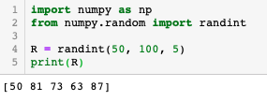
Namespaces
Rename sub-package
Import individual function
Notes:
Forgot to switch to spyer

Slide 8




Arithmetic
Numpy operations act elementwise, when applied to a numpy array
Elementwise addition
Elementwise multiplication
Elementwise exponential function

Slide 9
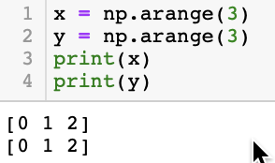
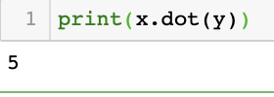
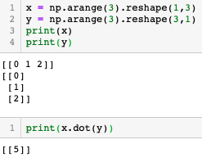
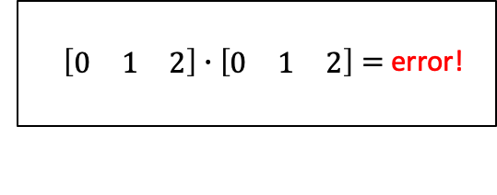
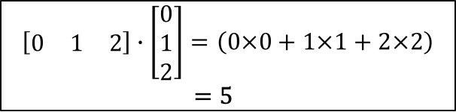
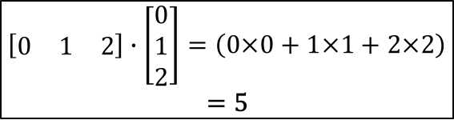
Linear Algebra
Matrix multiplication with dot
Numpy manipulates 1D array
$\left[\begin{matrix}0 & 1 & 2\end{matrix}\right]∙\left[\begin{matrix}0 & 1 & 2\end{matrix}\right]=$ error!
$$\left[\begin{matrix}0 & 1 & 2\end{matrix}\right]∙\left[\begin{matrix}0 \\ 1 \\ 2\end{matrix}\right]=\left(0×0+1×1+2×2\right)$$
$=5$
$$\left[\begin{matrix}0 & 1 & 2\end{matrix}\right]∙\left[\begin{matrix}0 \\ 1 \\ 2\end{matrix}\right]=\left(0×0+1×1+2×2\right)$$
$=5$

Slide 10
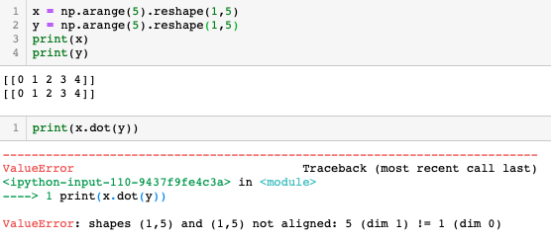
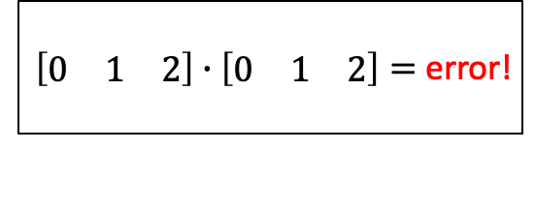
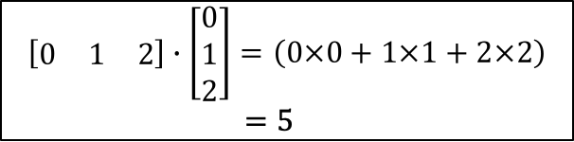
Linear Algebra
Matrix multiplication with dot
$$\left[\begin{matrix}0 & 1 & 2\end{matrix}\right]∙\left[\begin{matrix}0 \\ 1 \\ 2\end{matrix}\right]=\left(0×0+1×1+2×2\right)$$
$=5$
$\left[\begin{matrix}0 & 1 & 2\end{matrix}\right]∙\left[\begin{matrix}0 & 1 & 2\end{matrix}\right]=$ error!
Inner dimensions of 2D arrays must be equal
Notes:
Retake. Matrices the wrong way round

Slide 11
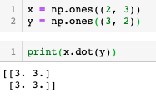

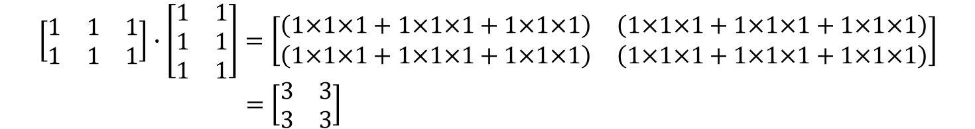
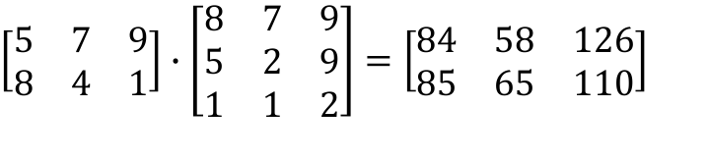
Inner dimensions are equal (n columns matrix A = m rows matrix B)
Outer dimensions determine size of output matrix
$$\left[\begin{matrix}1 & 1 & 1 \\ 1 & 1 & 1\end{matrix}\right]∙\left[\begin{matrix}1 & 1 \\ 1 & 1 \\ 1 & 1\end{matrix}\right]=\left[\begin{matrix}\left(1×1×1+1×1×1+1×1×1\right) & \left(1×1×1+1×1×1+1×1×1\right) \\ \left(1×1×1+1×1×1+1×1×1\right) & \left(1×1×1+1×1×1+1×1×1\right)\end{matrix}\right]$$
$=\left[\begin{matrix}3 & 3 \\ 3 & 3\end{matrix}\right]$
A
B
$$\left[\begin{matrix}5 & 7 & 9 \\ 8 & 4 & 1\end{matrix}\right]∙\left[\begin{matrix}8 & 7 & 9 \\ 5 & 2 & 9 \\ 1 & 1 & 2\end{matrix}\right]=\left[\begin{matrix}84 & 58 & 126 \\ 85 & 65 & 110\end{matrix}\right]$$
A
B

Slide 12
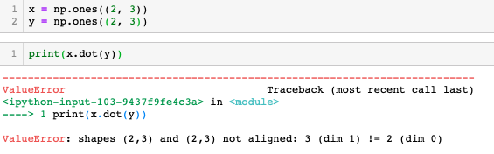


Matrices have same dimensions
Matrix multiplication
$$\left[\begin{matrix}1×1 & 1×1 & 1×1 \\ 1×1 & 1×1 & 1×1\end{matrix}\right]$$
Elementwise multiplication

